Slide 1

Graduate Project Defense Simulation of the light-skin interaction for PPG application
Kenza Benkirane
5eme annee Sciences et Genie des Materiaux - IFAG CSC E IN
July 27th, 2021

Slide 2

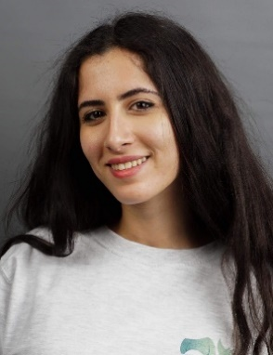








Brief introduction of myself
Academic background
2020 – 2021: Unitech Programme Participant
2020 – 2020: Erasmus : Biomedical Engineering, Politecnico di Milano
2028 – 2021: Materials Sciences and Engineering, INSA Lyon
2015 – 2018: CPGE – Physics and Chemistry, Lycee Janson-de Sailly
Practical experience
Kenza Benkirane
(IFAG CSC E IN)
03/2021 – 07/2021: Internship at Infineon Technologies SC Innovation
07/2020– 08/202: Internship at Skairos
06/2019– 08/2019: Internship at the Hospital for Special Surgery (HSS)
Notes:
First I am going to give you a brief introduction of myself.
My name is Kenza Benkirane, I am 24 years old and I am from Casablanca in Morocco.
After my high school diploma, I went to Paris in the intensive preparatory classes to prepare the entering to the Engineering Schools. My main focus was Physics and Chemistry. That‘s how I joined INSA Lyon in Materials Sciences and Engineering.
In August 2020, I joined the UNITECH Program, that gave me the opportunity to go Politecnico di Milano as an exchange student.
About my practical experience, I‘ve worked mainly in the biomedical and healthcare field. First, I was a data science intern at HSS, which introduced me to Python. Then, I‘ve work in a french startupm Skairos, where I discovered the clinical perspective of the field.
In March I started my intership at Infineon Technologies. Today I‘m going to present to you my projects and achievements.

Slide 3
Table of contents
1
Presentation of the company, division and department
4
2
Main Projects, Objectives and Achievements
8
2.1
PALS
2.2
PSS Reporting
3
Conclusion and internship added-value
19

Slide 4
Table of contents
1
Presentation of the company, division and department
4
2
Main Projects, Objectives and Achievements
8
2.1
PALS
2.2
PSS Reporting
3
Conclusion and internship added-value
19
Notes:
First, let me introduce you to Infineon

Slide 5



Infineon at a glance
Business Segments Revenue*
Employees*
Connected Secure
Systems (CSS)
46,700 employees worldwide
14%
EMEA 19,100
Automotive
(ATV)
Americas 5,200
Power & Sensor Systems (PSS)
29%
43%
Asia/Pacific 22,400
14%
60 R&D locations
19 manufacturing locations**
Industrial Power Control (IPC)
Financials
Market Position
7,063
7,599
8,029
8,567
Automotive
Power
Microcontroller
6,473
15.2%
17.1%
17.8%
16.4%
13.7%
# 1
# 1
# 3
Strategy Analytics, April 2021
Omdia, September 2020
Omdia, March 2021
Revenue
Segment Result
Segment Result margin
*2020 Fiscal Year (as of 30 September 2020)
**as of 1 April 2021
For further information: Infineon Annual Report 2020
Notes:
Infineon is one of the top 10 semiconductor companies. It’s separated in 4divisions :
ATV : Automotive Division
PSS : Power and Sensors Systems
Industrial Power Control
CSS : Connected Secure Systems
Large domain of applicatzion and of B to B clients. Especially as a Materials Engineer, it gave me great insight into the wide range of application of the semiconductor, but also how essential it is in nowadays society

Slide 6
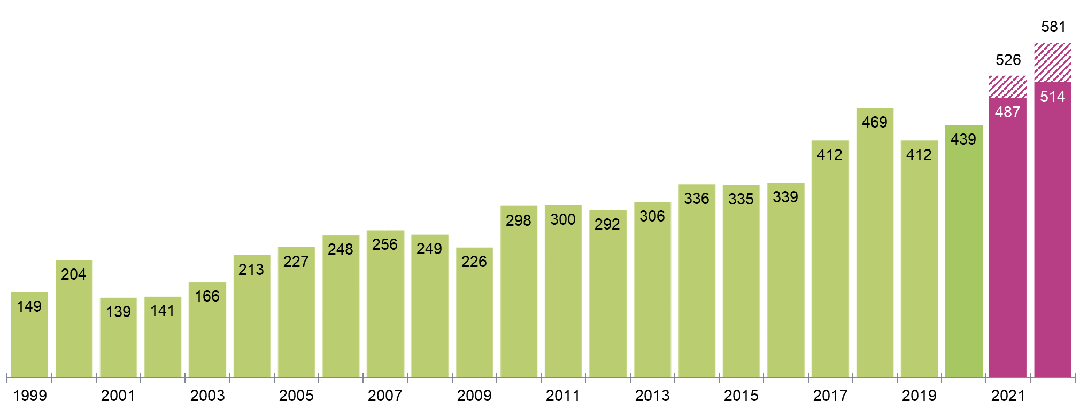
Semiconductor market will grow strongly in 2021 and 2022 according to forecasts
Global Semiconductor Market
Market size in billion US-Dollar
Market size (revenue)
Forecast revenue range
Source: WSTS for historical data. Forecast: ∅ of WSTS, Omdia, Gartner, IC Insights, VLSI Research; last update 26 April 2021
Notes:
The semiconductor market is expected to grow extraordinarelly quick, as we can see on this graph
This underlines two main challenges :
Chip manufacturing which takes a lot of time and takes a time to ainswer to a demand boom
Supply chain issues : SCI is at the center of this demand explosion

Slide 7
Supply Chain Innovation Department
Knowledge Management
Education and Administration
SC Trends, SC Simulation : Opportunities and Risks
AI, DL Quantum Computing
Digitalisation and Automation of Supply Chain Decisions
Semantic Web and IFX Knowledge Sharing
Business Process Analysis
Technology Aspiration
Notes:
Both aspects interesting and give an overview of SC

Slide 8
Table of contents
1
Presentation of the company, division and department
4
2
Main Projects, Objectives and Achievements
8
2.1
PALS
2.2
PSS Reporting
3
Conclusion and internship added-value
19

Slide 9


Presentation of my main projects
PSS
Bi-weekly report of the Business and SC KPIs
PALS
Biological and Optical model of the light-skin interaction

Slide 10
Projects and Learning Introduction
PSS Task
RoboScript
Tableau
PALS Project
Python Simulation
Machine Learning class
Project Definition

Slide 11
Time Distribution of the different projects

Slide 12
PALS : Proximity Ambient Light Sensor A passionate subject of multiple Master Theses in the last years
Alessandra Fuzco
Using PPG as a prevention tool
Melissa Romero Martinez
PPG signal processing and filtering
Eva-Maria Olweiner
Estimating the BP with Machine Learning
Fast Fourrier Algorithm Transform
Detailed approach to the PALS cardiac parameters
Homogeneous group training

Slide 13
PALS : Proximity Ambient Light Sensor A great teamwork and skills sharing
Electrical circuit
LED and Sensor
Processing and Visualisation Software
PPG
Monitoring
GUI Background
Patient-adapted questionnaire
Light-Skin Simulation
Peter
Kenza
Biomedical Engineering
Nanotechnologies
Product Design
Notes:
With this in mind, Peter and I started building

Slide 14
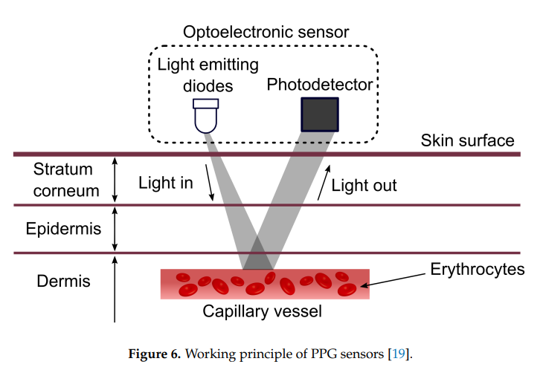
PALS : Proximity Ambient Light Sensor Defining the subject in more depth
Notes:
With this in mind, Peter and I started building

Slide 15
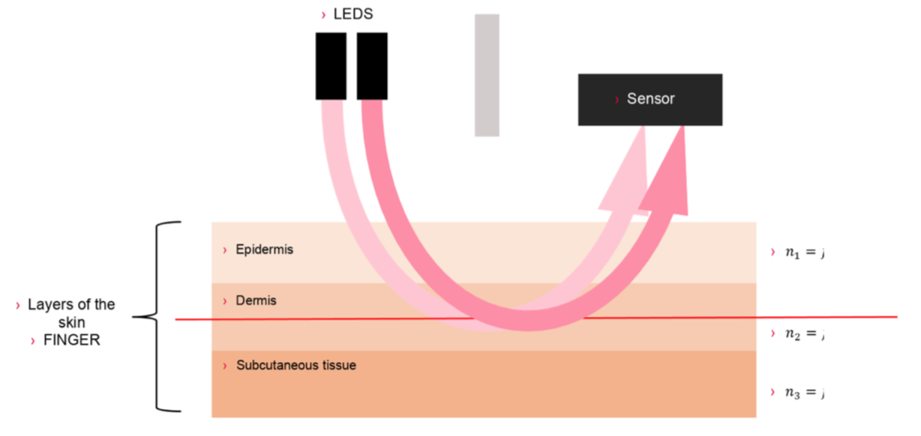
PALS : Proximity Ambient Light Sensor Defining the subject in more depth
Notes:
With this in mind, Peter and I started building

Slide 16
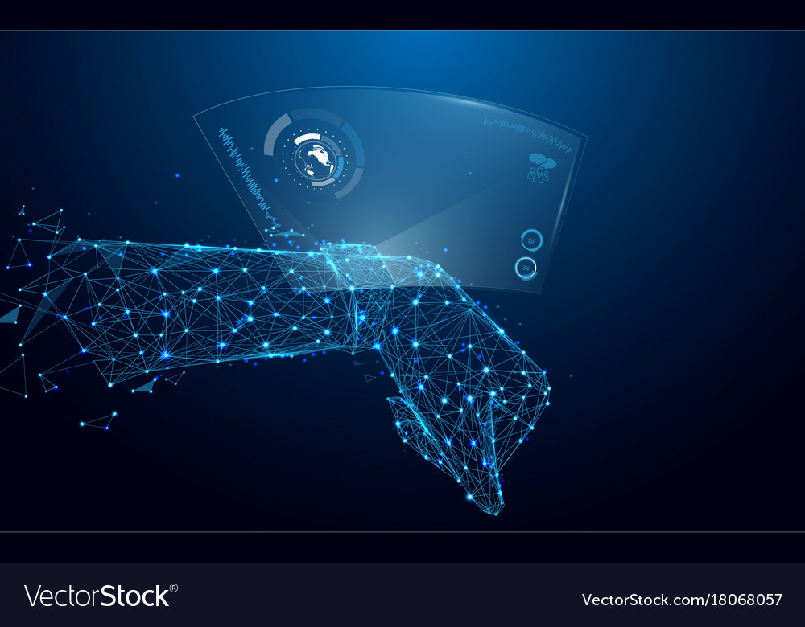
PALS : Proximity Ambient Light Sensor Problem Description and Value Proposal
PROPOSED SOLUTION
This simulation aims at evaluating the effect of three main parameters on PPG signal optimisation: - Wavelength - LED power
CONTEXT
- Healthcare is going through a deep transformation - PPG models are more popular - For PPG to become a replacement of ECG, it needs to be patient adaptative and accurate.
Notes:
- Healthcare is going through a deep transformation, engaging more the patient and technology. - PPG models are already used as a healthcare device in the US - For PPG to become a replacement of ECG, it needs to be patient adaptative and accurate.
One of the main struggle is accuracy and

Slide 17



Monthly Achievements Introduction to the project and first models
Mars
Project understanding Choice of subject
April
Starting the Front End Lab Access Biological Model
May
Photon Model Internship Report writing Back end writing
Notes:
March:
Thesis Reading : read all the thesis regarding PALS and PPG
Read the iOT report
Weekly meeting with Peter and Project Management :
-
QPR March
MOR March
Tableau tutorial on Youtube
Business Cockpit & Demand Change CW11
Feedback from BC and DC
MTC CW 11
April
GUI of the App
Machine Learning EDX Class
PPG sensor datasheets obtained from Infineon colleagues
Lab Access
Building the simulation
-
RoboScript tutorials
RoboScript automatization of the BC
Roboscript automatization of the DC
MTC CW 16
May
Oxygen saturation from the signal
Finish the theoretical part of the thesis ->better understanding of the "behind" of the code
Building the simulation

Slide 18


Monthly Achievements Code and writing finalisation in the last two months
June
Finished the back end First presentation of the prototype First draft of the internship report
July
Connected the front end and back end Code Documentation

Slide 19
Table of contents
1
Presentation of the company, division and department
4
2
Main Projects, Objectives and Achievements
8
2.1
PALS
2.2
PSS Reporting
3
Conclusion and internship added-value
19

Slide 20
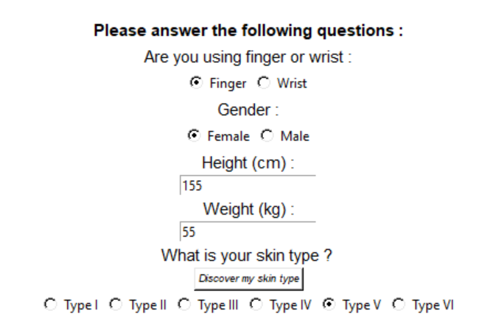
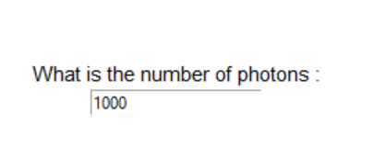
PALS : Proximity Ambient Light Sensor Desktop App and Patient parameters
LED Power
Melanin rate
BMI

Slide 21
Research
Analysis
Methodology
Comparison
Experiment process
Keeping the other parameters constant
Choosing the parameter
Measuring the variation for each wavelentgh
Trying to extreme values

Slide 22
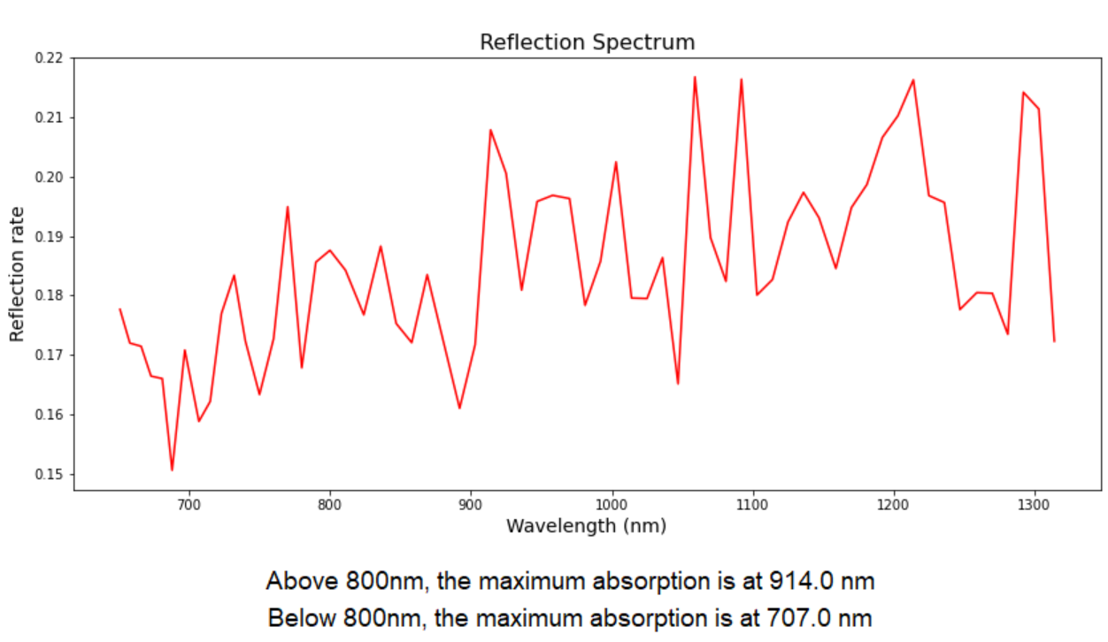
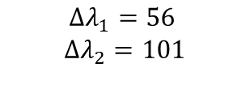
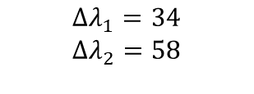
PALS : Proximity Ambient Light Sensor Results Analysis – wrist mode
Statistics
Melanin
BMI
$$Δλ_{1}=56$$
$$Δλ_{2}=101$$
$$Δλ_{1}=34$$
$$Δλ_{2}=58$$
How is the wavelength delta impacting the device accuracy ?
If you want to modify this graph, click on it, follow the link, change the data and replace it

Slide 23
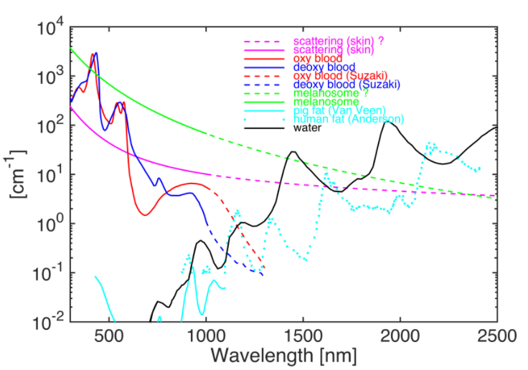
PALS : Proximity Ambient Light Sensor Interpretation of the results
Statistics
If you want to modify this graph, click on it, follow the link, change the data and replace it

Slide 24
Points of Discussion
Greater sample needed for a real analysis of the wavelength effect
Assert the accuracy with an ECG and the final PALS device
Patient-adapted study should get more insight from health professionals
Machine Learning Optimization is needed to access indeed cardiac parameters
Optimisation of the code architecture and velocity

Slide 25
Top 5 added value
1
Live in Germany and discover the German culture
2
Work in English : biomedical and business vocabulary
3
Being part of an international community
4
Discovering Supply Chain in a key industry in an important context
5
Learning about Business KPI and how to interpret them

Slide 26

Thank you for your attention
Kenza Benkirane
Graduate Project Defense Simulation of the light-skin interaction for PPG application

Slide 27














PSS at a glance : Power & Sensors Systems
PSS revenue and Segment Result Margin
FY20 revenue split by product group
[Mio. €]
681
759
779
787
617
Revenue
Segment Result
Segment Result margin
Key customers
Notes:
Presenter: Peter Wawer
Among other:
Resilience of business in Covid-year 2020 proven
Segment margin =
Revenue=

Slide 28

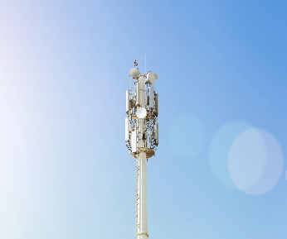
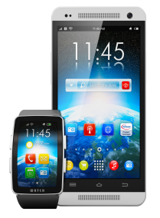

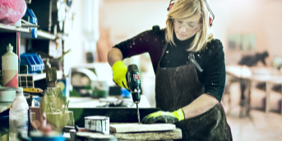



PSS's growth is built on many applications from different sectors in power and non-power
Computing
Communications
Smartphones
Consumer
Industrial
data center
enterprise server
PC, notebook
peripherals
chargers and adapters
base stations
backhaul cellular infrastructure
5G massive MIMO
telecommunication servers
smartphones
mobile devices
wearables
USB Type-C, USB Type-C PD
eBikes, eScooter
multicopter
LSEV
gaming
TV sets
smart home
power supplies
EV on-board charger
charging infrastructure
PV inverter
power tools
lighting
Industry 4.0
space

Slide 29
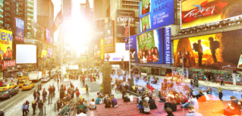



PSS business is driven by industry trends…
Global megatrends (relevant for our business)
Demographic & social change
Climate change & scarce resources
Urbanization
Digital transformation
Semiconductor market trends (market growth areas)
Energy efficiency
Mobility
Security
IoT & big data
Market applications (growth drivers for our business) – examples
Wireless charging
5G
AR/VR
Robotics
Data center
Lighting
Connected cars
eMobility
Drones & multicopters
Mobile payment
Smart home
Human machine interface
ADAS
Smart building
Advanced security
Smartphones
Wearables
Smart cities
Artificial intelligence

Slide 30


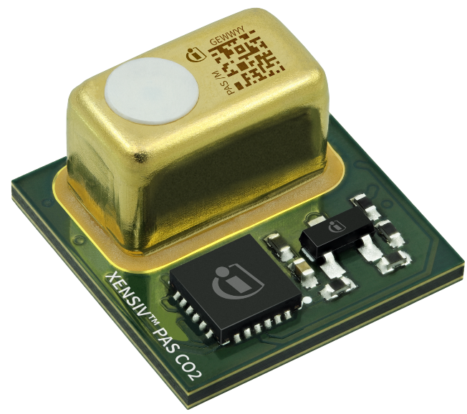
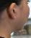
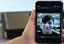

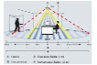


Main applications addressed by PSS sensors portfolio
MEMS microphone
3D radar (24/60 GHz)
3D ToF image sensor
Environmental
Best audio performance
Ultra-low power consumption
Best price / performance
High precision and Small form factor
14.0 x 13.6 x 7.5 mm³
Low power consumption
Presence detection/ Vital Sensing
Face ID (biometrics), VR/AR
Measure CO₂
Main applications
Smartphone
True wireless stereo headsets
Smart speaker
Laptop & Tablet
Automotive
Smart home
TV
Security camera
Smart building
Smartphone: world-facing and user-facing
Robotics
Automotive in-cabin sensing
Payment terminals
Heating, ventilation, air conditioning (HVAC)
Air purifier
Smart thermostat
CO₂/virus risk reduction
Notes:
Slide 65

Slide 31
Code Velocity according to the number of photons
Number of photons | Time (min)
100 | 2
1000 | 4
10 000 | 7
100 000 | 36
Possible solutions:
Greater CPU number
Ameliorate the code‘s architecture
Better front and back end merging

Slide 32
Working principle of PPG sensor
Source: Advances in PPG signal Analysis for Biomedical Applications

